Slide 1
Section 5.3 analyzing Graphs and Data

Slide 2
How data can be misrepresented:
Scaling the Y-axis → Reduce or Enlarge the increments to “downplay” or “exaggerate” the changes
Distorting images by changing their sizes in a bar graph or pictograph

Slide 3
Which graph is best?
When organizing data, we need to see if the graph provided is the best way to display the information
Things to remember:
  Circle Graphs – comparing different categories to a whole (100%)
  Line Graphs – changes in value over a period of time
  Bar Graphs/Double Bar Graphs – comparing the counts of different categories
  Every graph needs a title to describe what information it is giving
  Need to label both the X and Y axis

Slide 4
Ex: John did a survey, tallied the results and drew the following graph to illustrate his data. How can he improve his graph?
Favorite Ice-Cream Flavor
Ice-Cream
Count
Q: How can the graph be improved?
It’s missing a title and we don’t know what it is about
Label the both X-axis and Y-axis
The “Other” category is too big. Better to elaborate and split that
category into other flavors that people can choose

Slide 5
Ex: given the following information, indicate whether if the graph chosen is the best way to display the information:
Ie The following table shows the scores between two teams in four games that they’ve played against each other:
Game 1
Game 2
Game 3
Game 4
Q: Are the graphs misleading? If yes, how so?
Q: What are some disadvantages to showing the data with Circle Graphs?
Q: What other graphs would you display with instead?
Illustrate the data with another graph

Slide 6
Q: Are the graphs misleading? If yes, how so?
The graphs are not misleading but they don’t give us any useful
information
Q: What are some disadvantages to showing the data with Circle Graphs?
You don’t know what the exact scores are
You don’t know how many points each team won by
Q: What other graphs would you display with instead?
Double bar graphs to show the scores for each game
Canucks Vs Coyotes
Games
Score

Slide 7
Ex: Given the following set of data, draw two different graphs. Indicate the advantages and disadvantages with using each graph.
The staff at a hotel and their salaries are displayed in the graph below. Draw a graph to illustrate the different salaries and Number for each pay scale:

Slide 8
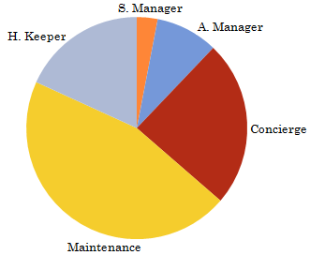
Number of Workers at
Hotel Staff (33)
Pay Scale for Hotel Staff
Staff
Salary (100k)

Slide 9
Hotel Staff and Salary
Salary (100k)
Count
Q: How is this graph misleading?

Slide 10
Homework:

